Slide 1
The Security Mindset
CYB101
Unit 1

Slide 2
Welcome to Unit 1: The Security Mindset
Turn on your camera
Rename yourself with your pod number and full name:
6 - Montero Hill
Answer the question below in the chat:
If you were a vegetable, which one would you be?
Notes:
TF Support Person Instructions: Add these directions listed in italics into the Chat.
Find your pod number here! https://courses.codepath.com/courses/cyb101/pages/groupings

Slide 3





As a community, we will...
Be present, physically and mentally
Actively build an inclusive community and space
Practice curiosity and adopt a learning mindset
Ask for help when we need it
Keep our cameras on

Slide 4
1 | Intro | 00:00 - 00:10
2 | The Security Mindset | 00:10 - 00:35
3 | Tabletop Exercises | 00:35 - 00:55
4 | Lab: Intro to Cyberchef | 00:55 - 1:55
5 | Wrap Up | 01:55 - 2:00

Slide 5
10 minutes
Examine the job description for Business Information Security Officer at Deloitte. Then, discuss the questions with your group:
What mindsets does the job require?
What skills or tools does the job require?
What terms in the job description are you familiar and unfamiliar with?
Notes:
Link to job description: https://archive.ph/Q3Sh7
Once students have read through the job description, solicit feedback from students.
Ask them how they answered the different questions
Make a note of terms that were unfamiliar to students as a teaching resource
Ask follow up questions, such as which mindsets, skills, and tools students already possess

Slide 6
The Security Mindset
25 minutes
Notes:
TF Support Person Instructions: Add these directions listed in italics into the Chat.
Add your questions here!
https://docs.google.com/spreadsheets/d/1MwwAlrh9RwXWyX_cCWQZkCMlKECYmp-hZJ15dqO6Icw/edit#gid=0

Slide 7

Security is a mindset. It's a way of thinking about the world.
If I’m [a] hacker, I get to attack whenever I want. I get to do it at the most inopportune time [for you]. I get to do it in a way that makes your system fail as badly as possible.
To get into the security mindset is to try to understand the unexpected directions from which attacks might come.
– Bruce Schneier: The Security Mindset
Notes:
Read more from the original paper here: https://www.computer.org/csdl/magazine/co/2016/02/mco2016020007/13rRUx0gelC

Slide 8

Building a Security Mindset
Built over time, not overnight
Involves asking lots of questions like:
How do you craft an environment that can withstand ever-evolving security threats?
When an attack occurs what will you do to address it?
How will you ensure data privacy within your organization?

Slide 9
The CIA Triad is a model designed to guide policies for information security.

Slide 10

People Assets
People
Employees, contractors, vendors, visitors
Notes:
TF Support Person Instructions: Add these directions listed in italics into the Chat.
Add your questions here!
https://docs.google.com/spreadsheets/d/1MwwAlrh9RwXWyX_cCWQZkCMlKECYmp-hZJ15dqO6Icw/edit#gid=0

Slide 11



CIA Triad Definitions
Confidentiality
Data is kept private, secret, and secure
Integrity
Data and security are always accurate and reliable
Availability
Systems remain available to users when needed

Slide 12
CIA Triad Examples
Confidentiality (opposite: disclosure)
Authentication is required to view data
Integrity (opposite: alteration)
Checksums are used to detect high-level data errors
Availability (opposite: unavailability)
Backups and redundancy keep systems online

Slide 13


Let’s use a real company as an example...
Twitter

Slide 14

Twitter & the CIA Triad
Users expect DMs, personal information, and payment information to be kept private
Confidentiality
Users expect that Tweets they send won’t be intercepted and altered, and that their data won’t be corrupted
Integrity
Users expect to be able to login and send a Tweet or browse their feed any time
Availability

Slide 15
Company Assets
Organizational resources used to maintain operations and achieve organization’s mission
Critical assets are unique to each organization
Several broad categories, such as:
People
Information
Technology
Facility
Notes:
Read more about these different types of assets here: https://www.cisa.gov/protect-assets

Slide 16


Information Assets (1 of 2)
Data
Employee PII, proprietary information, documents
Customer Information
Contact and purchase details

Slide 17


Information Assets (2 of 2)
Processes
Supply chain connections
Systems
Data collection, alarms

Slide 18
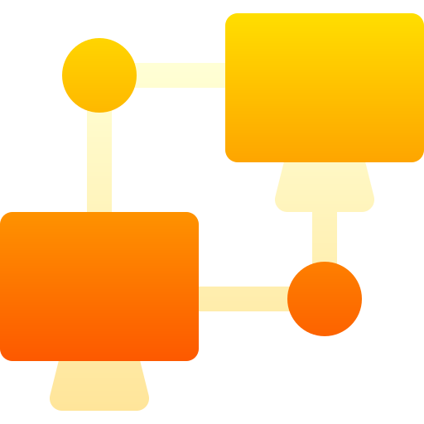
Technology Assets
Technology
IT systems, networks, communications

Slide 19


Facility Assets
Facilities
Buildings, land
Equipment
Vehicles, machinery

Slide 20
Twitter & the CIA Triad
Twitter’s staff, influencers who use their platform, contract moderators
People
User and staff personal data, proprietary algorithms for sentiment analysis, ranking, malware detection
Information
Internal IT and networking systems
Technology

Slide 21
Vulnerabilities, Threats, and Risks
Vulnerability: a weakness or flaw in a system, process, or set of controls
Allows for exploitation
Threat: when an attacker has the opportunity, capability, and intent to exploit a vulnerability
Affects confidentiality, integrity, or availability (CIA triad)
Risk: the probable frequency and magnitude of loss
Notes:
TF Support Person Instructions: Add these directions listed in italics into the Chat.
Add your questions here!
https://docs.google.com/spreadsheets/d/1MwwAlrh9RwXWyX_cCWQZkCMlKECYmp-hZJ15dqO6Icw/edit#gid=0

Slide 22
Twitter Vulnerabilities
Discovered in 2016 via Twitter’s bug bounty program, a user could create a Direct Message deeplink and insert a malicious HTML payload
Cross-site scripting (XSS)
Also via the bug bounty program in 2022, an attacker could locate any user’s email and phone number even if that information was set to private
PII Discoverability
Notes:
Some more interesting security vulnerabilities here: https://www.cvedetails.com/vulnerability-list/vendor_id-14415/Twitter.html
Read more about the XSS bug here: https://hackerone.com/reports/341908
Read more about the PII discoverability bug here: https://hackerone.com/reports/1439026

Slide 23
Twitter Threats
As in a 2020 hack of Joe Biden, Barack Obama, others, an attacker was able to phish employees to obtain admin credentials
Social engineering
An attack in late 2016 targeted Twitter, Spotify, and others, making the websites inaccessible for nearly a full day
DDoS Attack

Slide 24
Twitter Risks
High probability, low loss risk
Spam
Low probability, high loss risk
Account takeover

Slide 25
Threat Actors
Any entity (e.g. person, organization) that is responsible for a cybersecurity incident
Many types of threat actors
Nation-state actor: government-sponsored groups (usually Russia, Iran, North Korea, or China)
Hacktivist: promoting a political agenda or social change
Cybercriminal: an entity perpetrating a crime for financial gain, retribution, etc.
Insiders: an entity within an organization that deliberately or unknowingly causes an incident

Slide 26
Twitter Threat Actors
A group hacking Twitter in order to extort users and collect Bitcoin
Cybercriminals
A person buying out the company in order to intentionally weaken its security
Perpetrator of hostile takeover

Slide 27
Controls
Any policy, procedure, or action designed to mitigate cybersecurity risk
Designed to meet control objectives
Example: “Our controls provide reasonable assurance that access to databases is restricted to authorized users”

Slide 28



Control Functions
Preventative
Designed to stop cybersecurity incidents before they occur
Detective
Designed to detect or alert to incidents after they occur
Corrective
Designed to restore resources to their prior state after an incident occurs

Slide 29



Control Types
Physical
Tangible deterrents, such as fences, guards, and badges
Technical
Hardware or software, such as antivirus software and authentication
Administrative
Policies and guidelines, such as audits and data classification

Slide 30
Twitter Controls
[Technical, detective] Deploying accounts to attract, detect, and thwart spammers and malicious accounts
Honeypots
[Administrative, corrective] A document used to define the process for responding to a threat
Incident Response Plan

Slide 31
Mitigating Vulnerabilities
Can use a knowledge graph of vulnerabilities and countermeasures, such as Mitre Att&ck and Mitre D3fend
Stay current with the OWASP Top 10, an “awareness document” with the most critical risks to web applications
Review the CIS Top 18 Critical Security Controls, including inventory, malware defense, etc.
Notes:
Open up the Mitre link and demonstrate how to use the knowledge graph: https://d3fend.mitre.org/

Slide 32
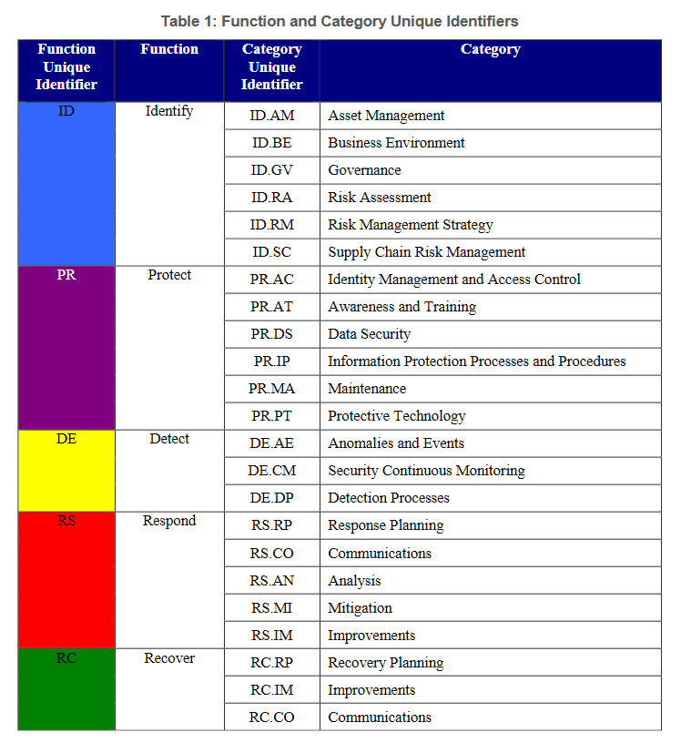
Improving Cybersecurity
NIST Framework for Improving Cybersecurity provides guidelines for organizations
Helps assess and mitigate risk
Notes:
Read the full framework here: https://nvlpubs.nist.gov/nistpubs/CSWP/NIST.CSWP.01162020.pdf

Slide 33
Tabletop Exercises
20 minutes

Slide 34
20 minutes
Open up the Tabletop Exercises document. With your group:
Introduce yourself!
Name and year
Do you prefer tea, coffee, or something else?
Discuss the three scenarios and answer the questions together.
We will discuss as a group when time is up.
@[handle]
Notes:
TF Support Person Instructions: Add these directions listed in italics into the Chat.
Find your pod number here! https://courses.codepath.com/courses/cyb101/pages/groupings
Link to the tabletop exercises document! https://docs.google.com/document/d/1fZJjkRDYUq8505NjvWsGhGzByzF7dJdVVhPa8w2tPIc/edit?usp=sharing TF Support Person Instructions: Add these directions listed in italics into the Chat.
PLEASE DO NOT REQUEST ACCESS TO THIS DOCUMENT. Make a copy if you wish to make changes.

Slide 35
Break Time!
Take 5 mins to step away from the computer. Feel free to turn off your camera and return promptly after 5 mins.

Slide 36
Lab: Intro to Cyberchef
60 minutes

Slide 37
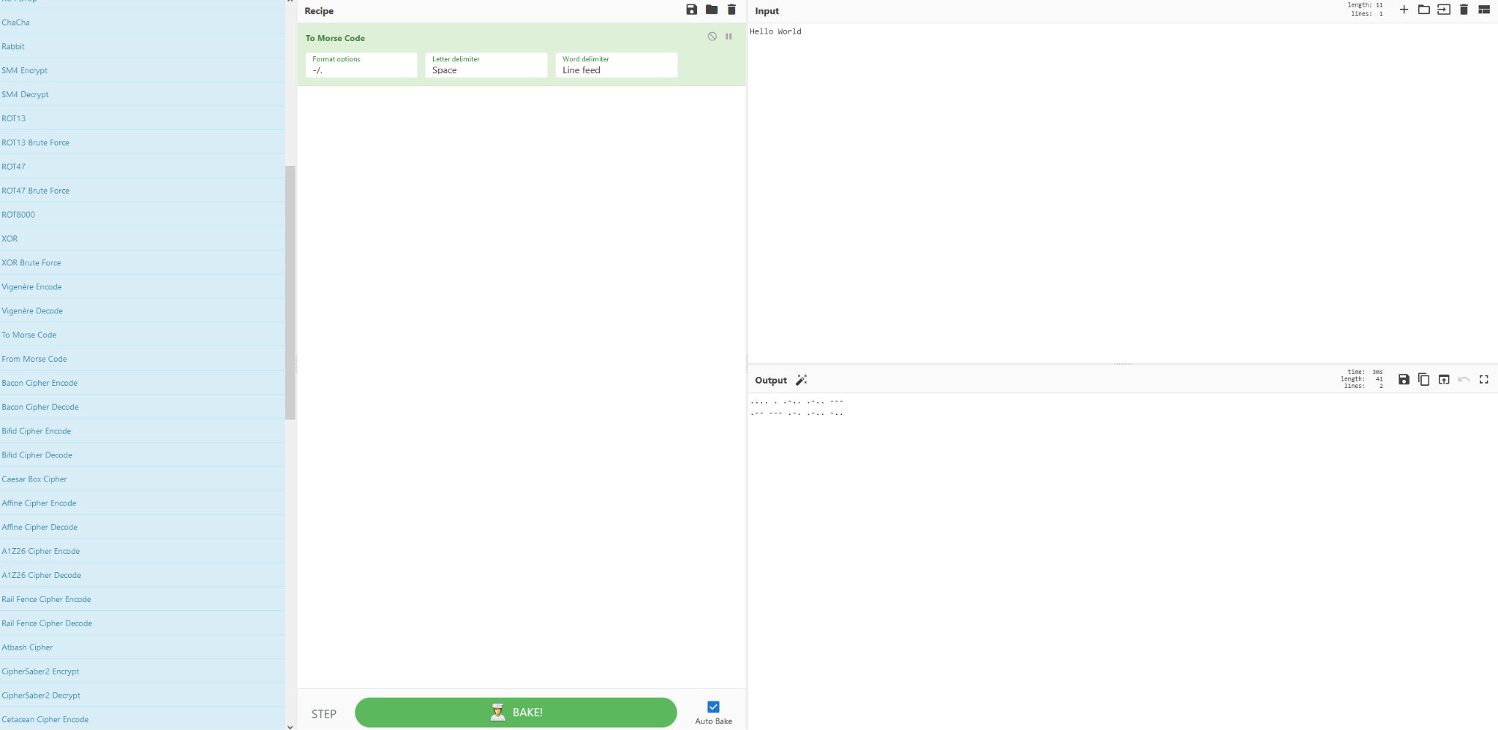
Lab: Intro to Cyberchef

Slide 38
60 minutes
Navigate to the Lab tab in the course portal
Complete the Lab!
@[handle]
Notes:
TF Support Person Instructions: Add these directions listed in italics into the Chat.
Link to the lab! https://courses.codepath.org/courses/cyb101/unit/1#!labs

Slide 39
Wrap Up
5 minutes

Slide 40
Project Preview
Use Cyberchef to solve Capture The Flag type challenges
Use research (aka Googling), critical thinking, and problem solving skills to help you solve CTF challenges.

Slide 41
Before you leave...
Complete the Session Survey (5 minutes)
Reminder: complete the Project before our next session!
Next session: Encryption 🔒
Notes:
TF Support Person Instructions: Add these directions listed in italics into the Chat.
Leave your feedback here! https://forms.gle/7jE9W5cfjowadk7C7

